Slide 1


ANIMAL HUSBANDRY
By: Hitesh Sharma (181500272)
Jai Sharma (181500289)
Pranshul Agrawal (181500484)
Shubhang Verma (181500703)
Loving
your pet like you do

Slide 2
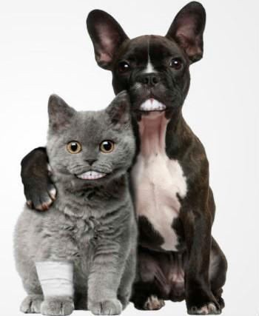
Introduction
￼
Animal Husbandry is an app which makes it easy for you to know more about your pet.
It answers your questions regarding their behaviors and health issues.

Slide 3
Motivation
Nowadays whenever our pet or domesticated animal shows any sign of unusual behaviour/behaviours or suffer from some unknown underlying health issue/issues the first thing we do is get online and scrape various websites to gather information in order to know the set of actions one should take, which is sort of time-consuming and one can never be sure whether the information found is legit or not. Keeping these points in mind we decided to build an app that cuts short time consumption and helps boost search efficiency where you can get reliable information about health-related topics/issues you search on.

Slide 4

Why ﬂ utter?
Apps developed in ﬂutter don’t takes much time to build.
Hot reload
Flexibility of cross-platform development.
Flutter app development = native experience + saves development time.

Slide 5
Why Dialogflow ?
It’s easy to use.
Helps to track chatbot’s performance with built-in analytics tool.
Supports 20+ global languages.

Slide 6
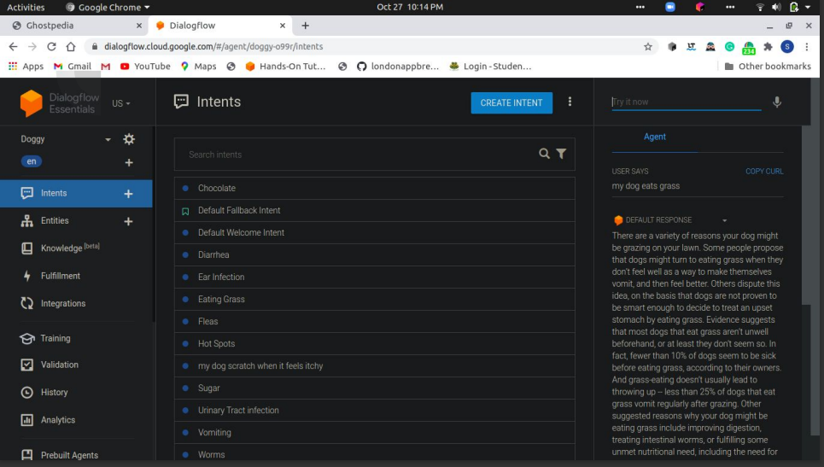

Slide 7



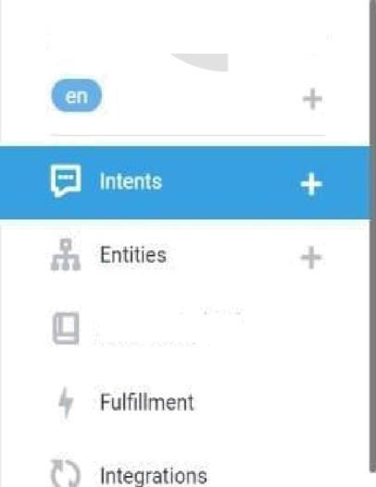

Diacgfiw Essenbtls
«s-
;:” Intents
try it now
my cattle deny to eat
what are the 9,easons battle Wnn”t Drink?
G bacterium
Q DefaulF6IIbâcklnent G Default Welcome|ntent
my cattle deny \o eat
''I F.*.I II I ii :»Hf ill!›I w
1f your cattle arenoteating food,nneofthe m0stlike|y suspects Is Ketosis occurs when cows inlake more feed energy than†hey expend. Pregnant battle are at theirgreatest risk for ketosis as they nearthe endnf their gestation period, when calf embryo development ismost advanced and energy drain on the mother is at its highest. At{hat
point nt cows hecome restless and go
of their feed.
Knowledge !""!
G Drink
G Fall and Winter
o healfh
0 HeatUress
G humans gel sick
Training
Validation
G Injured
History
G lumpy skin
i", I I h f health
G Respilatory Diseases
.\i Analytics
G Sick Castle

Slide 8
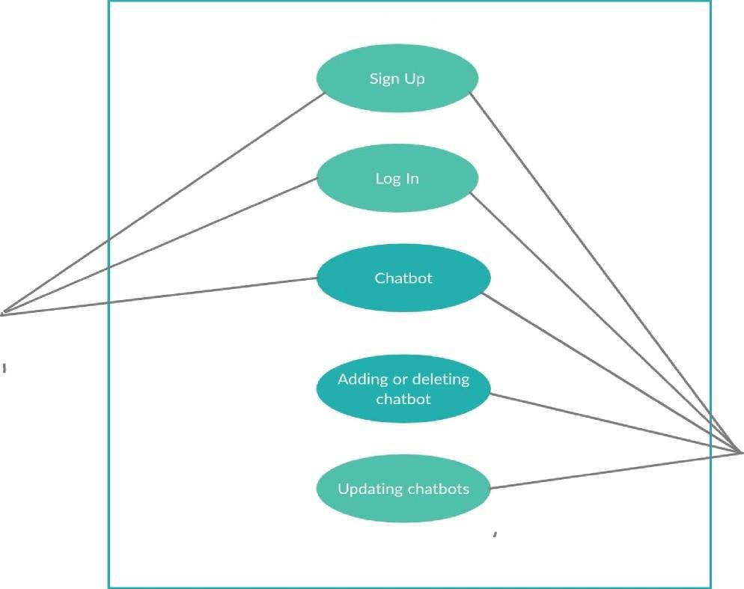


Use-Case Diagram
System
User
Admin

Slide 9
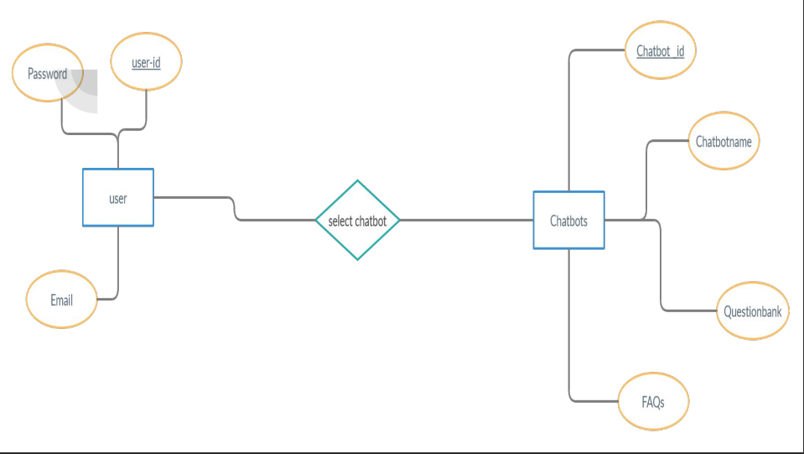
0-Level DFD

Slide 10
Software Requirements:
Flutter (1.20.1)
Android Studio (3.6) Android Emulator

Slide 11
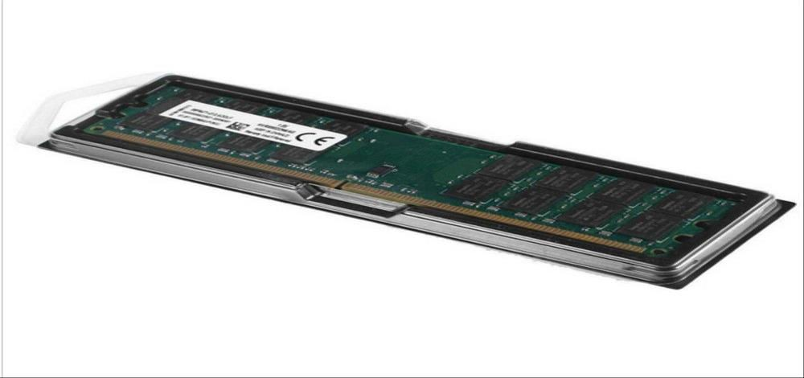
Hardware Requirement:
A system having at least 4GB of RAM.

Slide 12
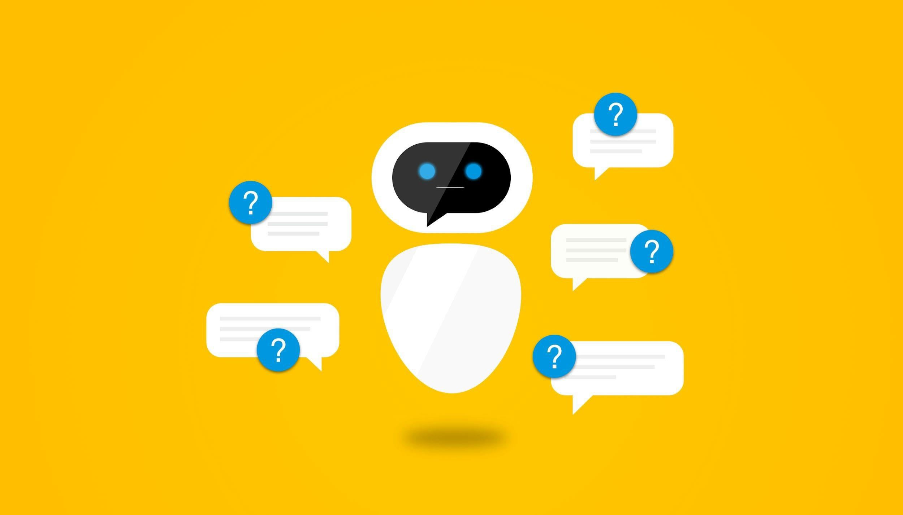

Slide 13

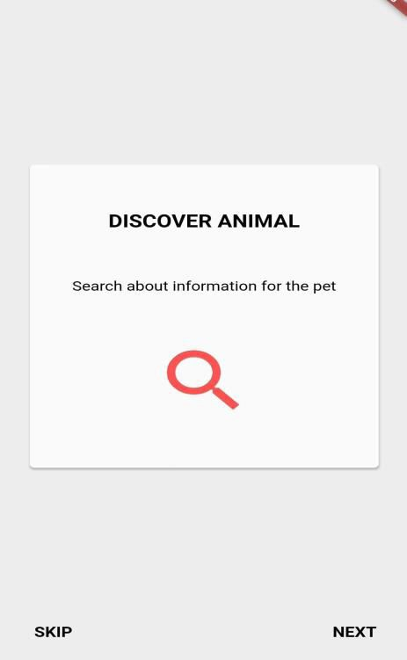
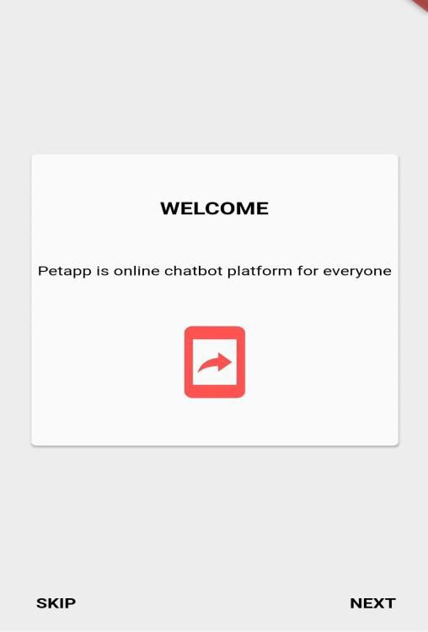
Splash Screen

Slide 14
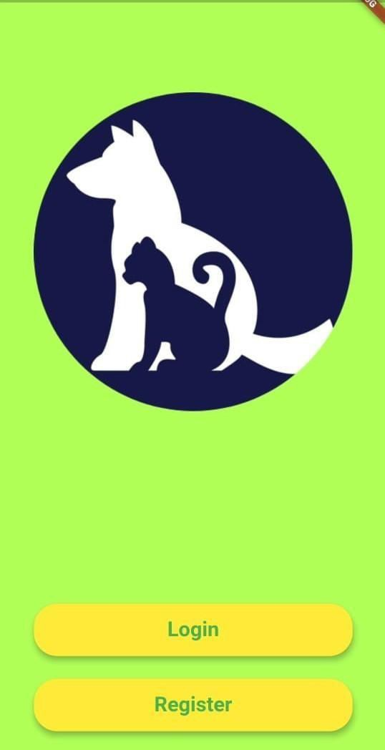
Welcome Screen

Slide 15
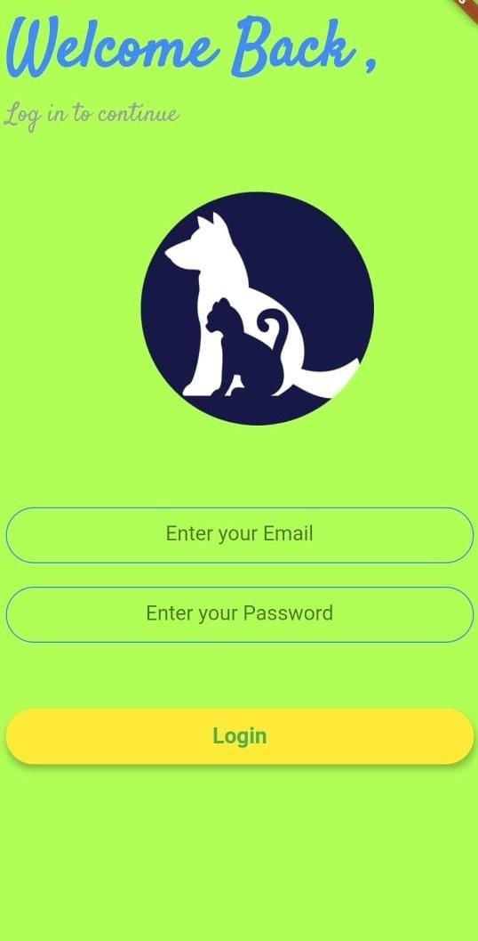
Login screen

Slide 16
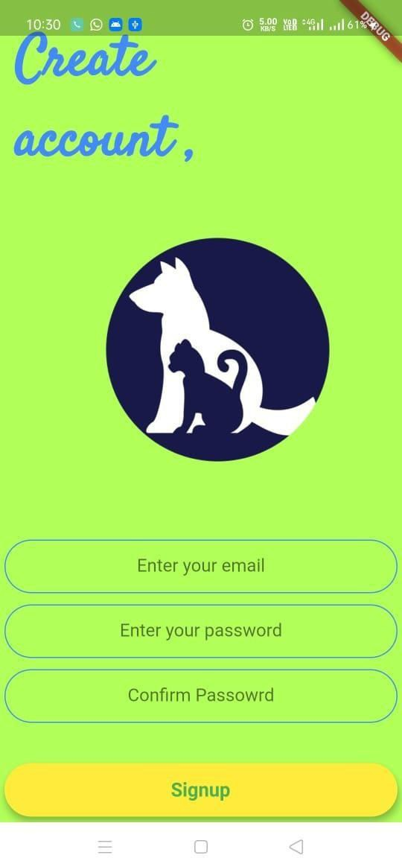
Registration screen
￼

Slide 17


